Slide 1

Microsoft new studio opening
Myra kadenge

Slide 2
Overview
Microsoft wants to establish its presence in the film industry by launching a new movie studio.
This presentation aims to provide an understanding of the business, the data provided as well as a brief description of the data analysis.
Based on the insights gained from the analysis, expect to find a few recommendations for microsoft on how to open a profitable studio.

Slide 3

Business Understanding
Recognizing the transformative power of original content and the growing demand for diverse storytelling, micrsoft has decided to open its own new studio.
This underscores Microsoft’s commitment to innovation and desire to engage audiences in new and exciting ways.
Microsoft aims to leverage business insights to produce compelling films that captivate audiences.

Slide 4
Data understanding
Datasets related to the movie industry, including data on box office performance, movie genres, studio profitability and audience ratings.
Contents: movie titles, release dates, box office revenues, genre classifications, studio affiliations, and audience ratings.
Data Cleaning: thorough cleaning and pre-processing to address missing values, duplicate entries, and inconsistent formatting, ensuring the integrity.

Slide 5
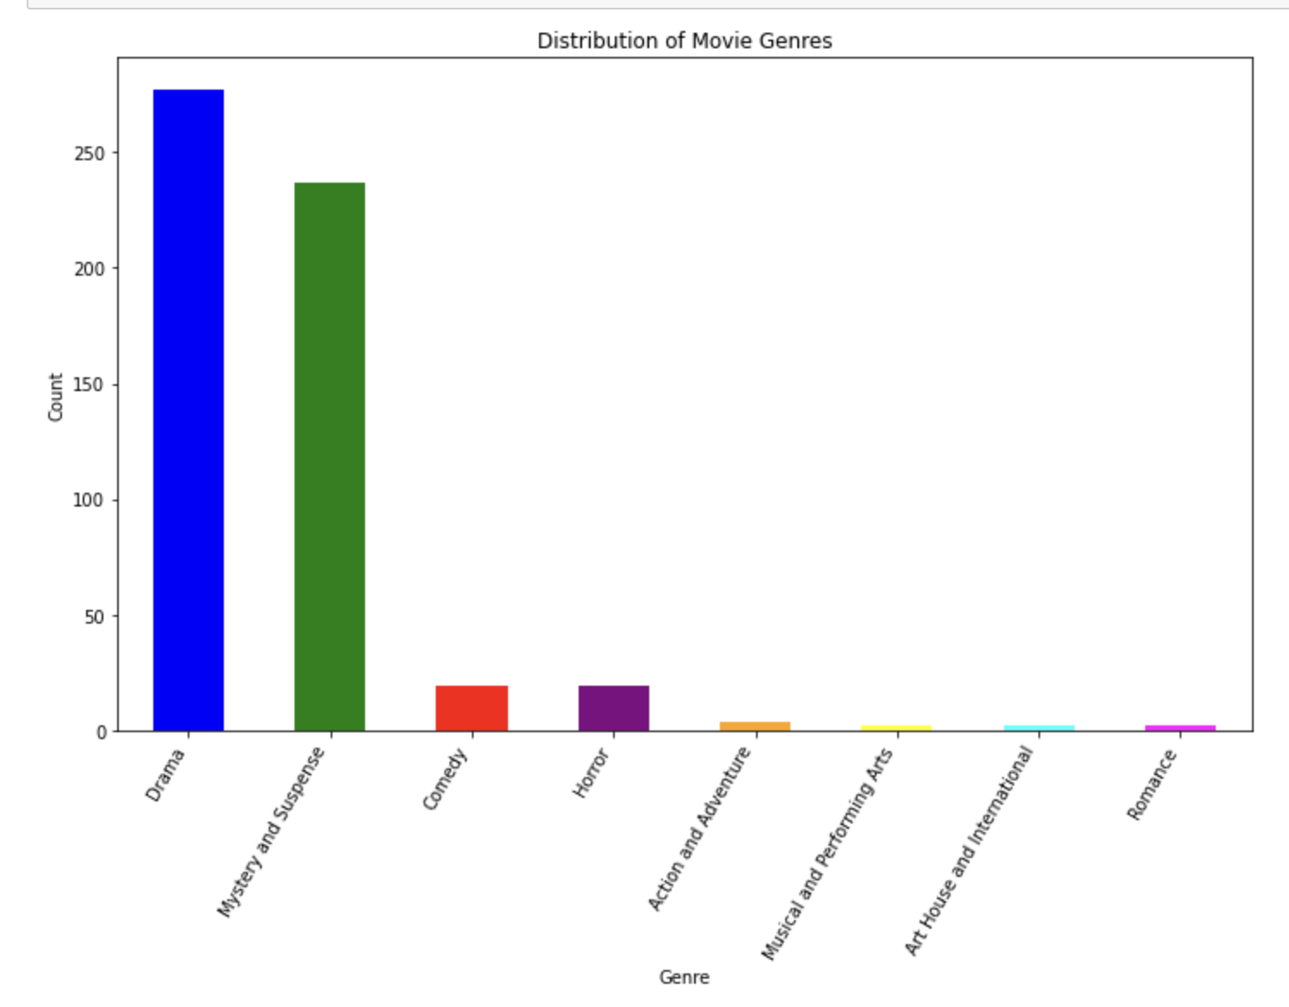
Most popular Genres
The bar graph shows that drama genre has the highest count or popularity followed by mystery and suspense.
A good indicator on which genre to focus on.

Slide 6
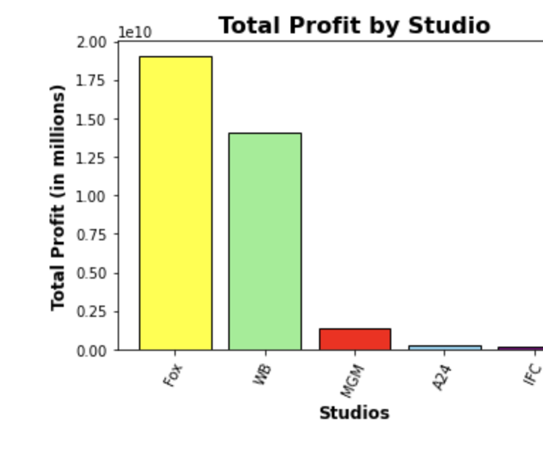
Most profitable studio
Fox studio is the most profitable compared to all other studios in production of movies.

Slide 7
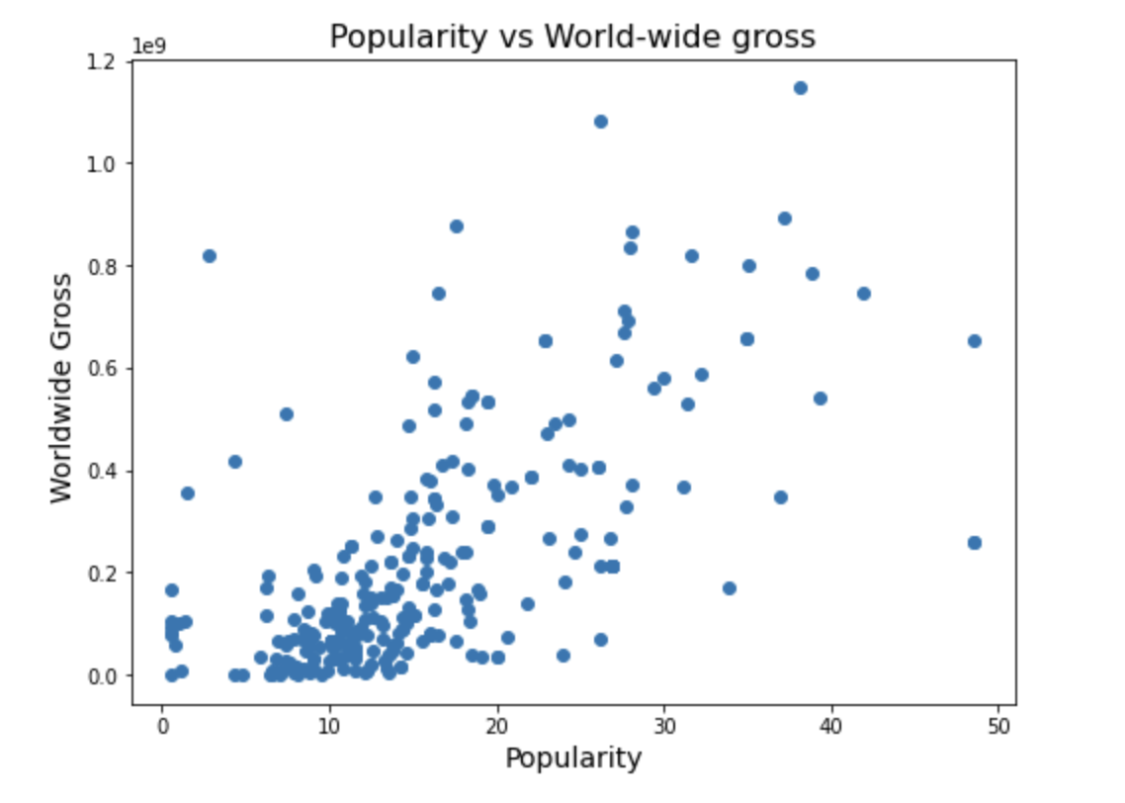
Correlation between popularity and worlwide gross
This scatter plot shows a positive correlation between popularity and revenue suggesting that a greater sense of popularity may signify higher revenue from the respective popular movies.

Slide 8
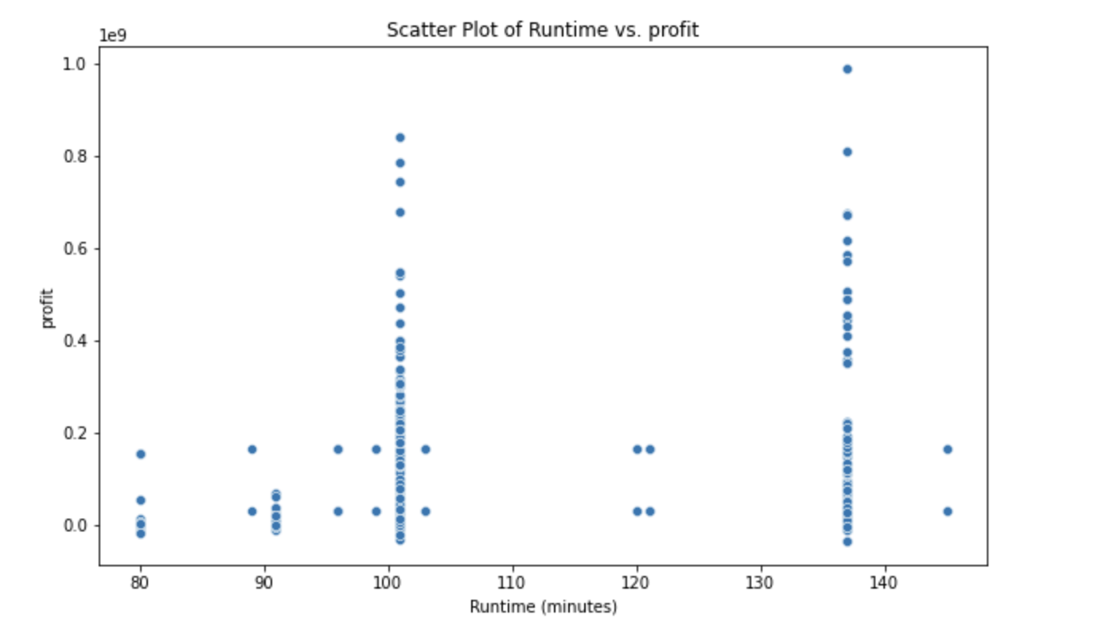
Does the runtime affect the profits?
There does not seem to be any significant relationship between runtime and profits hence Microsoft does not need to pay too much attention to the runtime of their movies.

Slide 9

Recommendations
Focus on drama as a major genre in productions.
Hire Fox studio before starting their own from scratch for insights or try form a partnership with fox studios for resources.
Focus on most popular movies to gain traction and high profits.

Slide 10

Please ask your questions ☺

Slide 11

Thank you ☺

